Slide 1
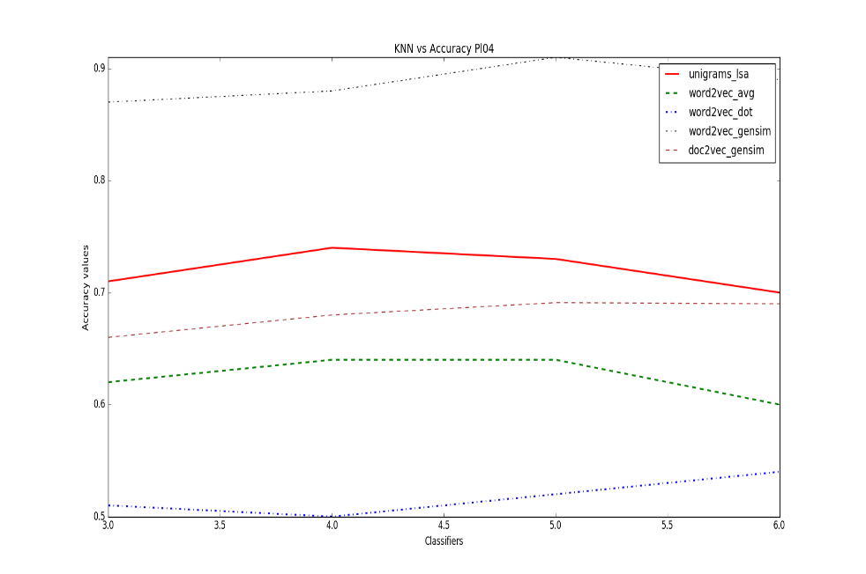
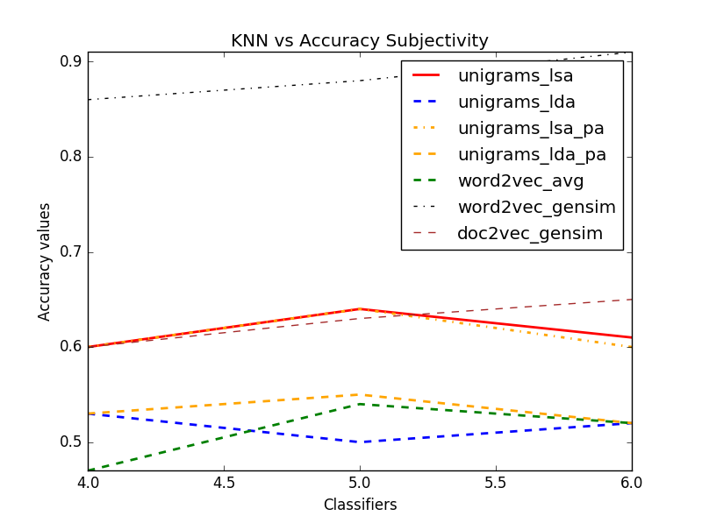
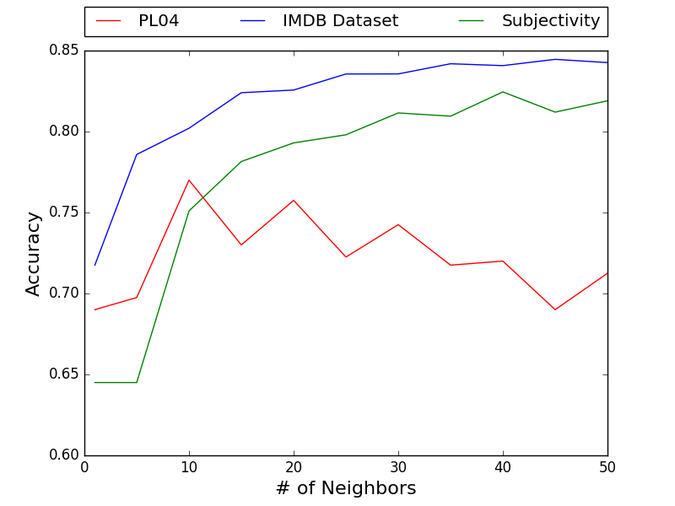
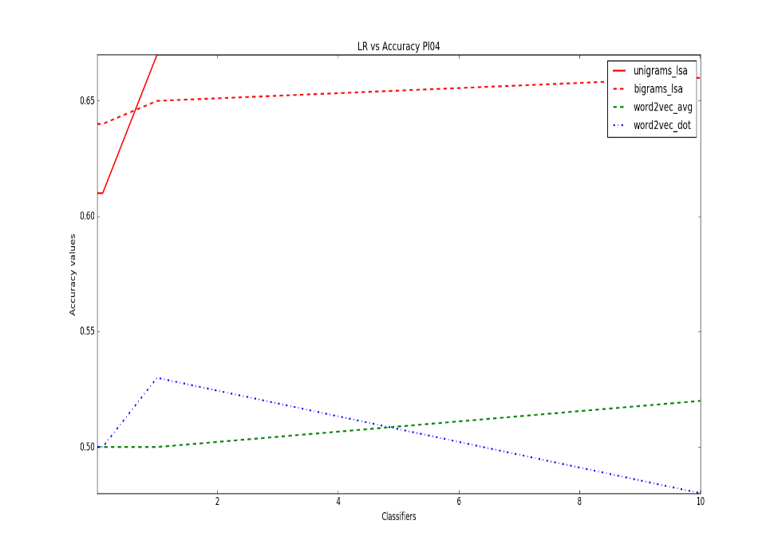
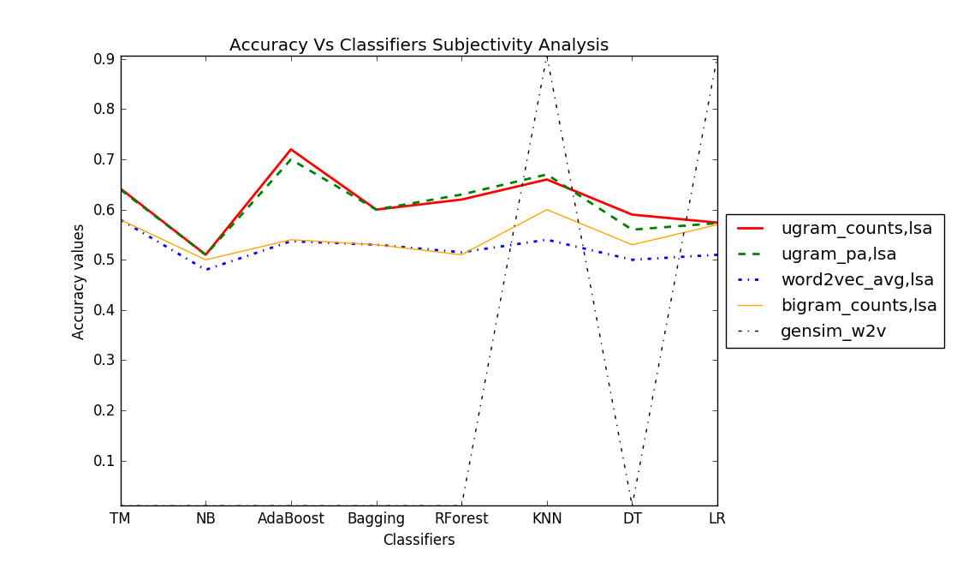
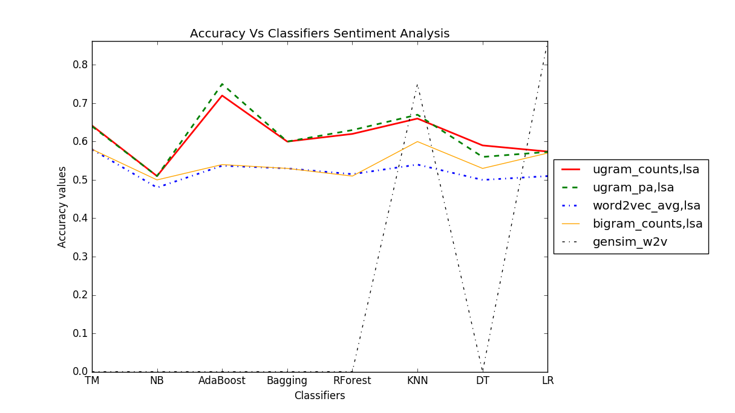
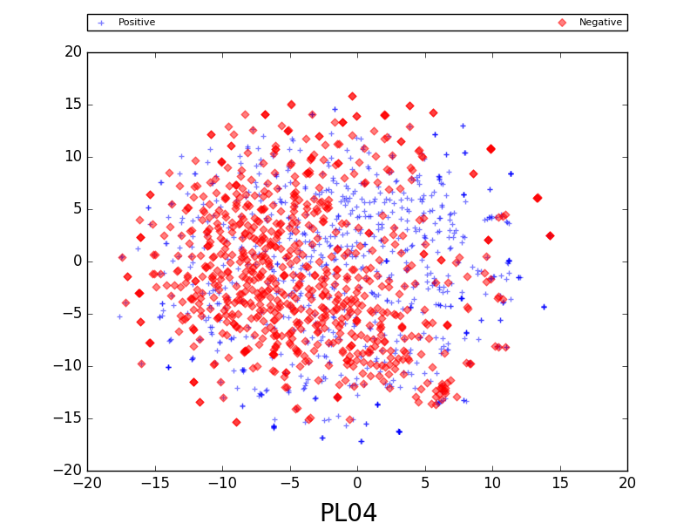
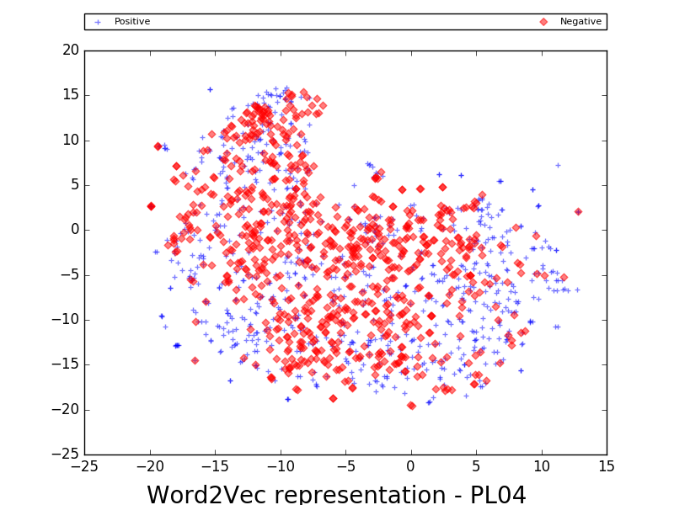
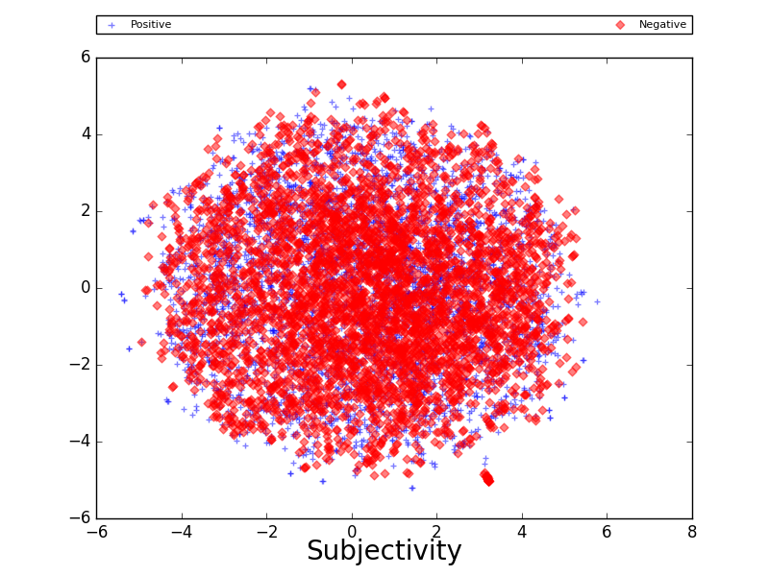
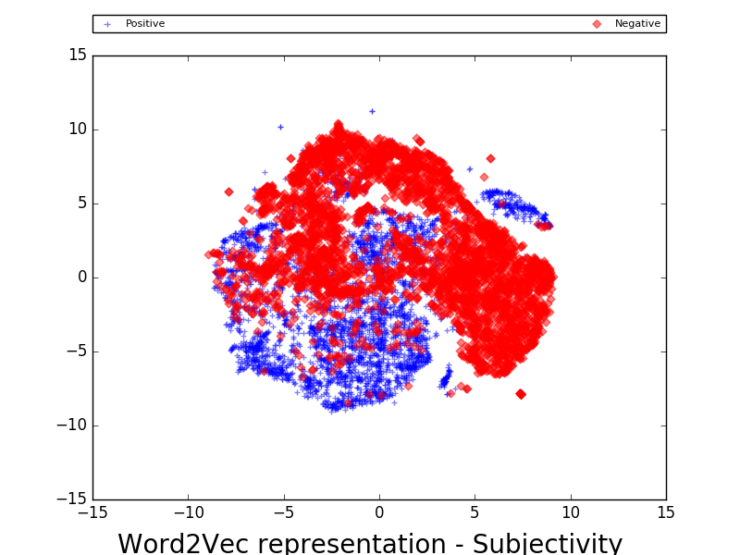
Sentiment Analysis using Word Vectors
A T J and N S B
University of Massachusetts, Amherst
Introduction
Results
Sentiment Analysis is the task of trying to determine the underlying emotion or feeling of the writer from a text of words. It could be useful for many applications like analysis of product reviews by product makers, movie makers etc. It also helps in assessing the psychological condition of a patient and determine if he or she is suffering from a case of chronic depression or not etc. We worked towards the classification of subjectivity and sentiment in documents obtained from the datasets mentioned below. Sentiment determines polarity of a document while subjectivity says if the author is subjective or objective in his opinion.
In this project, we evaluate different word and document vector representations for sentiment and subjectivity analysis over three datasets – Review Polarity Dataset, IMDB Dataset and Subjectivity Dataset.
We compared document representations such as bag of words (unigram) count frequency, bag of words (unigram) presence / absence representation, bigram word dependencies, and word vectors learnt from LDA, LSA, word2vec and use them with classifiers such as Naive Bayes, K-Nearest Neighbors, Decision Trees, SVM, Ensemble/Boosting classifiers. We hope to build different pipelines with stages of preprocessing, feature extraction, classifier training, hyper parameter selection and come up with the best that performs across all the data sets.
As expected, the best hyper parameter accuracies of 86.5% on Pl04 dataset, 90.8% on subjectivity dataset and 89% on IMDB dataset are obtained by simple tokenizer , Doc2Vec feature representation from genSim and using Logistic Regression as the classifier.
Using a set of words as positive and negative, when we did a dominant polarity analysis per document, we got a result of 64% accuracy on subjectivity and 55% on sentiment dataset.
Accuracies of KNN with different features on PL04
Accuracies of KNN with different features on subjectivity
Text preprocessing
Lower case conversion
Punctuation Removal
Tokenization
Sinple/Binary/Advanced
Tokenizer
Feature Extraction
Unigram Counts
Bigram Counts
Unigram.Bigram LSA
Unigram/Bigram LDA
Word2vec
Doc2vec
Classifiers
LogReg
NaiveBayes
Knn
DecisionTree
Accuracies of Simple tokenizer,Doc2Vec, KNN on all the datasets.
Accuracies of LR with different
Features on PL04.
Accuracies of different pipeline options on subjectivity dataset.
Accuracies of different pipeline options on Pl04 dataset.
Methods
Tokenization, Punctuation marks Removal
Simple Tokenization – words split by space and converted to lowercase
Advanced Tokenization – words split by
Bigram Tokenization
We also tried to tokenize in the corpus using a Regex tokenizer from nltk.
Models for Document Representation:
.”Bag Of Words” in which the position of words does not matter. It also assumes that the words are conditionally independent given the class to which they belong. We tried counts of unigrams, bigrams, presence or absence statistics of them, length normalized, scaled representations etc.
Latent Dirichlet Allocation
This is a form of dimensionality reduction algorithm that also learns to represent words as vectors as a word-topic matrix. Each document is assumed to be a combination of latent topics.
Latent Semantic Analysis.
This is a vector space model which explicitly learns semantic word vectors by
applying singular value decomposition (SVD) to factor a term–document co-occurrence matrix.
Word2Vec
Gensim is used to extract vector representations for words in our corpii. Words that are similar or closer in semantic meaning have similar representation.
Doc2Vec
Gensim is used to extract vector representations for words and sentences in our corpii. Words , documents that are similar or closer in have similar representation.
Classifiers:
We used Knn, Decision trees,Logistic Regression and other such classifiers from the sci-kit learn package of python.
T-sne rep of doc2vec word vectors- PL04,subjectivity datasets
T-sne rep of word2vec word vectors- PL04,subjectivity datasets
Conclusions
We have noticed that working on features like unigram/bigram counts
with or without dimensionality reduction techniques like LDA/LSA, the accuracies are not so high and sentiment analysis is better in performance than subjectivity.
We will further implement code to leverage the benefits of neural networks with word/document vectors, assign sentiment tag to each word in a document and sum the document sentiment.
Bibliography
https://en.wikipedia.org/wiki/Word2vec
Pang, B., & Lee, L. (2004). A sentimental education: Sentiment analysis using subjectivity summarization based on minimum cuts. In Proceedings of the 42nd annual meeting on Association for Computational Linguistics (p. 271). Association for Computational Linguistics.
Maas, A. L., Daly, R. E., Pham, P. T., Huang, D., Ng, A. Y., & Potts, C. (2011). Learning word vectors for sentiment analysis. In Proceedings of the 49th Annual Meeting of the Association for Computational Linguistics: Human Language Technologies-Volume 1 (pp. 142–150). Association for Computational Linguistics.

